Slide 1
UMP JSC
DEVELOPMENT STRATEGY 2018-2028

Slide 2
Mission
Perspective
Strategic Targets
UMP JSC
Mission
Миссия, Видение, Стратегические
цели
Provide the world nuclear power, electronic, metallurgical and other industries with high tech products
Perspective
Become a priority business partner in the world nuclear power and strengthen the achieved positions in the deliveries of high-quality Beryllium, Tantalum and Niobium products with the focus on long-term goals of customers, staff, shareholders and the Company
Strategic Targets
ST 1: Enter into new markets of NPP fuel with higher value added products
ST 2: Increase the UMP JSC share in the fuel components world market
ST 3: Expand marketing and increase sales volumes of higher value added Beryllium products
ST 4: Keep a share of UMP JSC in the world markets of Tantalum, Niobium and Fluorine bearing products and increase a share in separate market segments (sputtering targets, super alloys, capacitors)

Slide 3
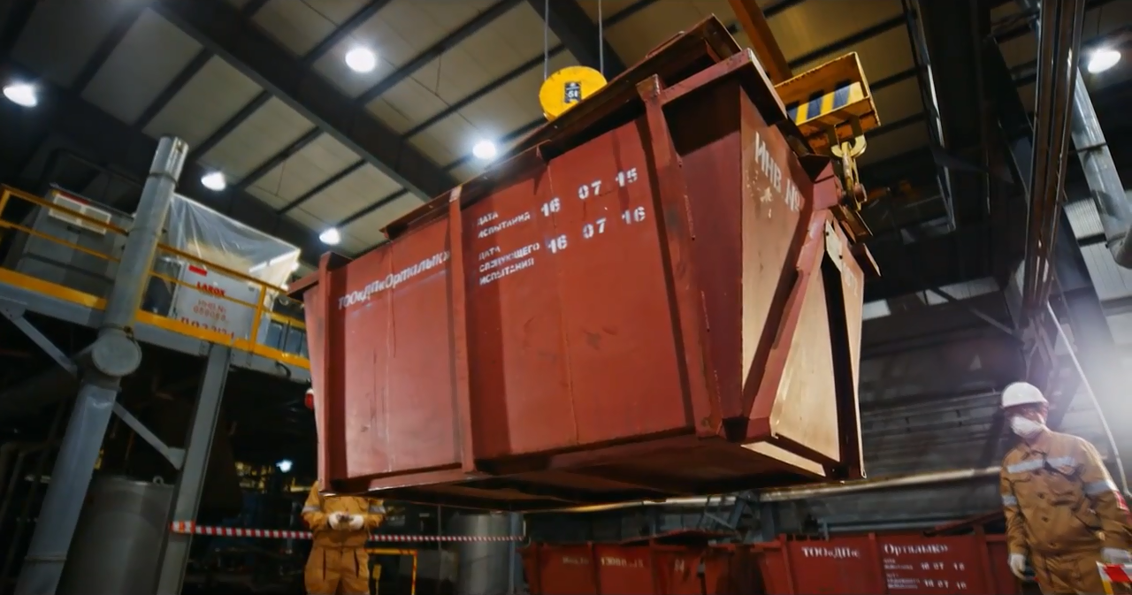
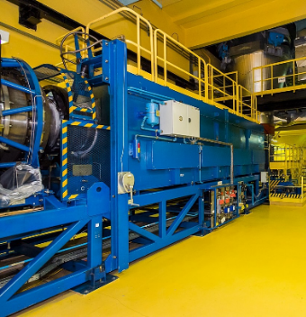
URANIUM BUSINESS
ST 1: Enter into new markets of NPP fuel
with higher value added products
ST 2: Increase the UMP JSC share in
the fuel components world market
UMP JSC
ЗА22.2
TARGETS
Expand U3O8 production
Increase production volumes of fuel pellets and uranium oxides
Enter into the new markets of fuel pellets
Establish the manufacturing site of uranium and gadolinium fuel rods

Slide 4
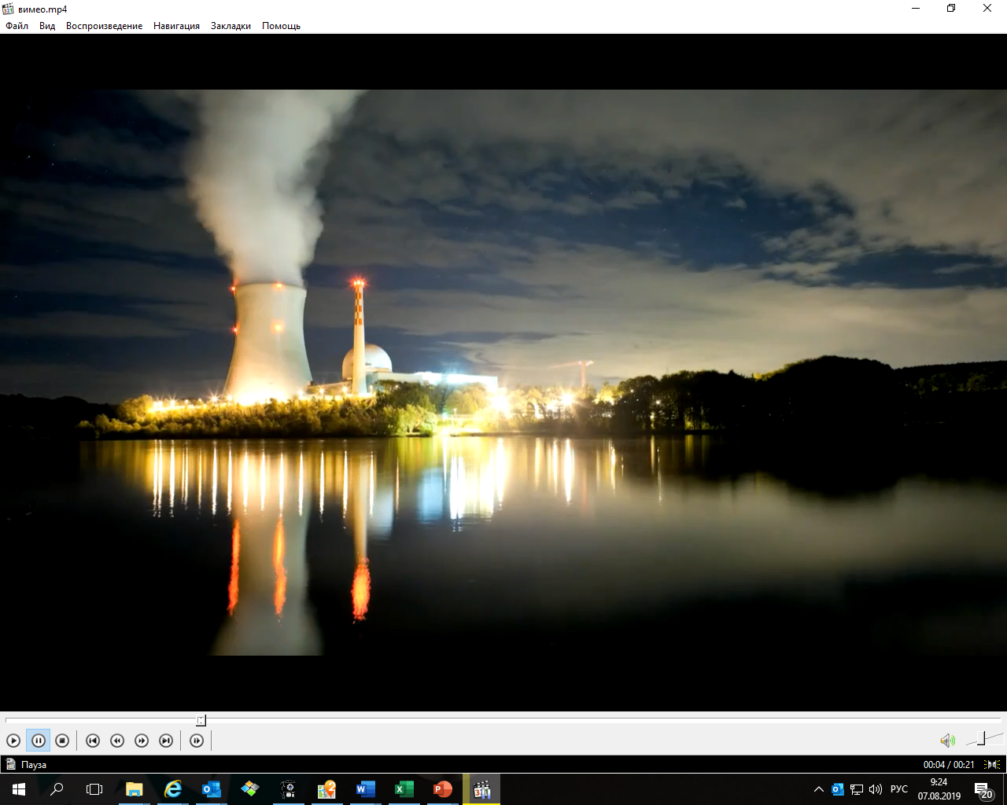
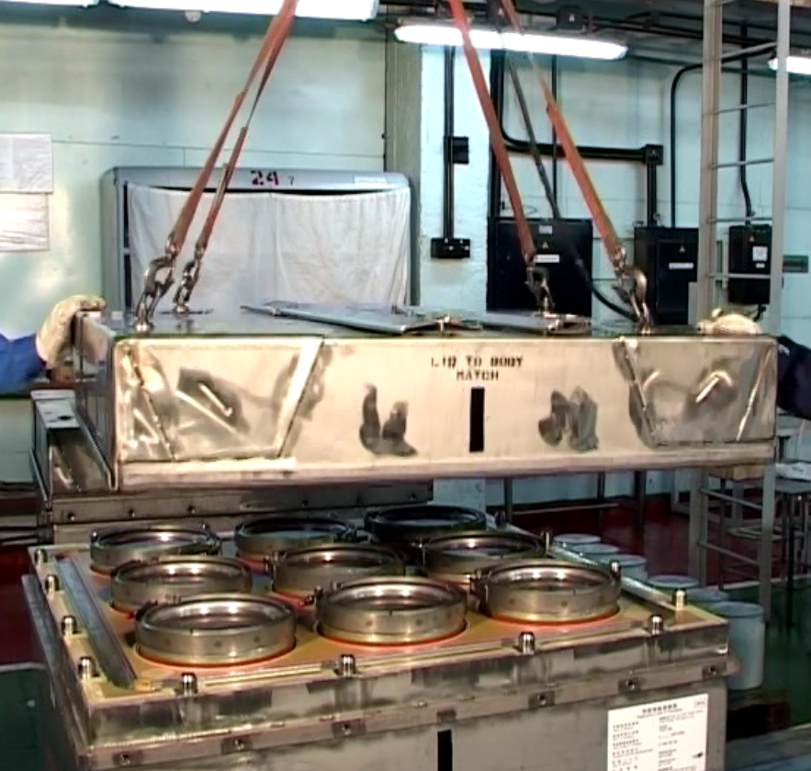
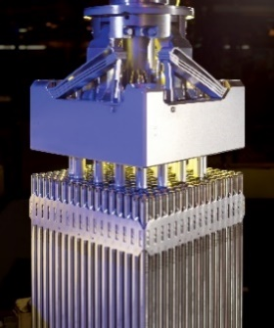
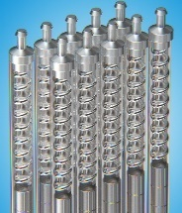
URANIUM OPERATIONS
in 2028
UMP JSC
ЗА22.2
Uranium oxides deliveries to:
Westinghouse
GNF-A
Machine Engineering Plant plc
EdF
Kansai/Sumitomo
Orano
Ulba-FA JV
Fabrication of the French design FAs for the Chinese market
Fuel pellets deliveries to:
Ulba-FA JV
Westinghouse
Uranium and Gadolinium fuel rods for
Ulba-FA JV
U3O8 production with the capacity of 6,100tU/year

Slide 5
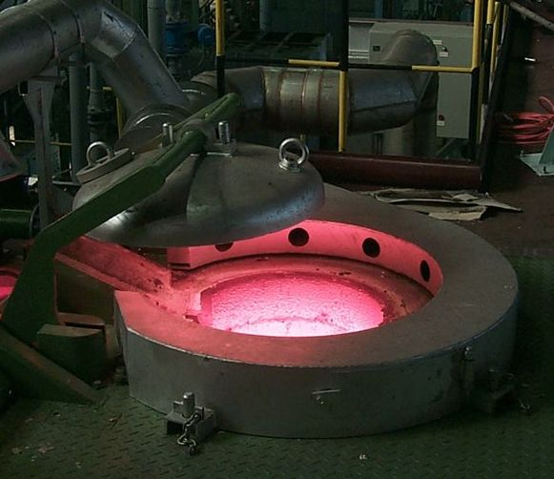
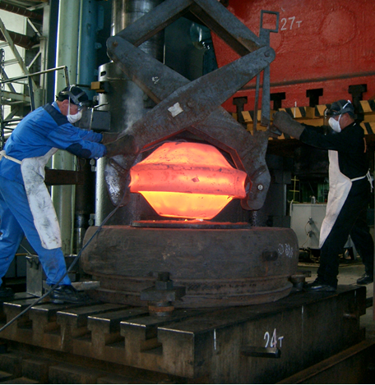
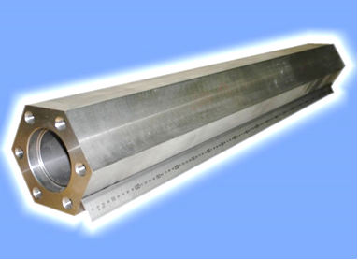
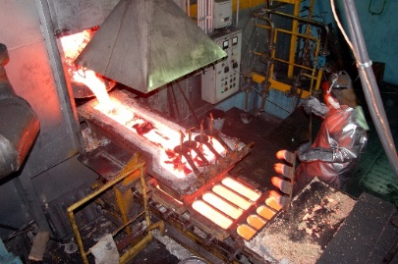
Beryllium business
ST 3: Expand marketing and
increase sales volumes of
higher value added Beryllium
products
UMP JSC
ЗА22.2
TARGETS
Upgrade Beryllium Operations in order to:
Expand a range of products;
Increase volumes of higher value added products.
Implementation date - 2019-2023

Slide 6
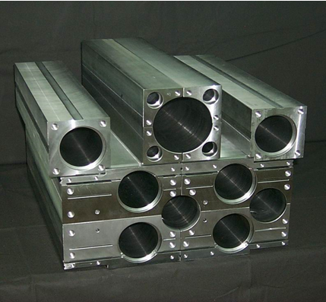
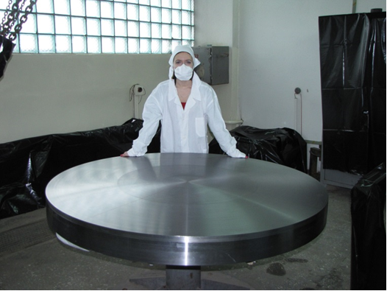
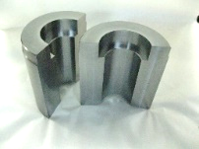
Beryllium operations
in 2028
UMP JSC
Increased sales volumes of:
Technical grade Beryllium metal;
Sintered technical grade Beryllium articles and billets;
Beryllium Copper

Slide 7
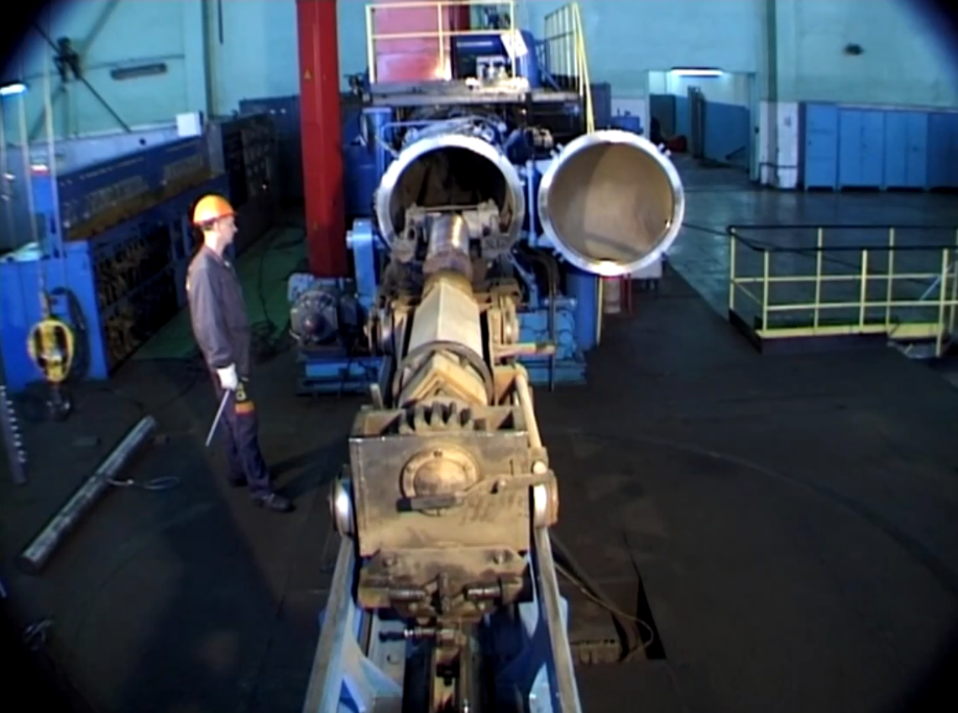
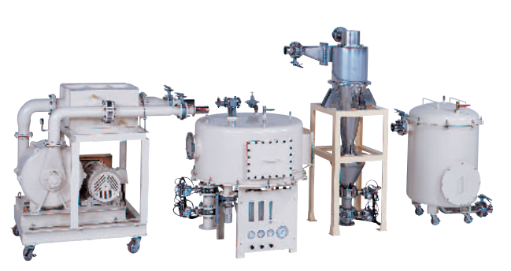
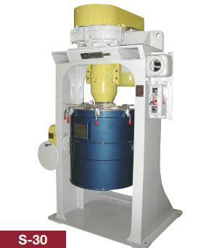
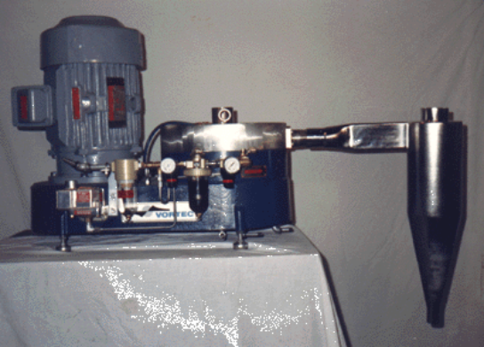
TANTALUM BUSINESS
СЦ 4: Keep a share of UMP JSC in the
world markets of Tantalum, Niobium and
Fluorine bearing products and increase
a share in separate market segments
(sputtering targets, super alloys,
capacitors)
UMP JSC
ЗА22.2
TARGETS
Establish a stable source of the raw material and the intermediate product (PFT).
Upgrade Tantalum Operations in order to:
Expand a range of products;
Increase volumes of higher value
added products

Slide 8
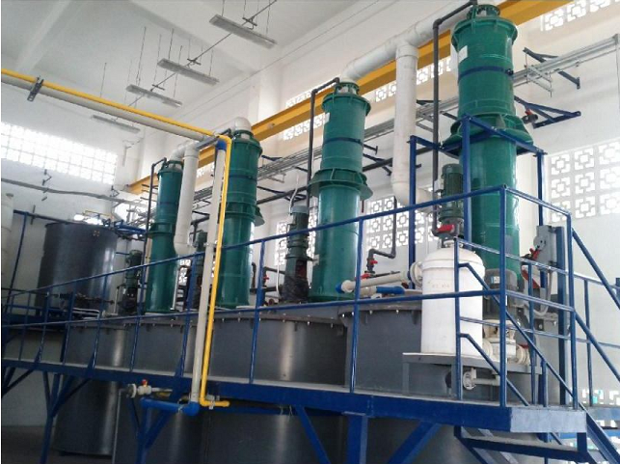
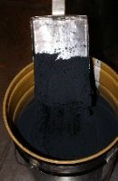
TANTALUM OPERATIONS
IN 2028
UMP JSC
ЗА22.2
Highly remunerative manufacture of higher value added Tantalum products
Own source of the raw material and new products
Production and sale of:
Potassium Fluorotantalite
Optical and technical grade Niobium pentoxide
Electronic grade Tantalum and Niobium pentoxide
Production of high-demand Tantalum and Niobium products:
High CV powders
High precision mill products
Sputtering targets
High purity ingots

Slide 9
HR Policy
UMP JSC
TARGET
ЗА22.2
MEANS
Maintain and develop the competencies of employees to ensure quality of the labor force of the existing and newly established facilities of UMP JSC
Competitive selection
(including among graduates of the Bolashak program, EKSTU, MEPhI, TPU, MIS&A, VET), internship, training, retraining, advanced training, personnel reserve, assessment and certification
Staff Number Dynamics, people
HR Policy of Ump JSC is aimed at attracting and retaining qualified staff

Slide 10
STRATEGIC OUTLOOK
OF THE UMP’ S
PRODUCTS IN THE
WORLD MARKETS
UMP JSC
АО «УМЗ»
ЗА22.2
Deliveries to:
Russia
Japan
USA
Canada
China
Germany
Romania
Korea
Turkey
Great Britain
Brazil
Austria
Belgium
Czechia
France
Belarus
Greece
Hungary
Italy
Holland
Norway
Poland
Sweden
Argentina
Australia
India
Switzerland
UMP JSC

Slide 11
АО «УМЗ»
UMP JSC
ЗА22.2
Thank you for your attention!

